Slide 1

Sentiment Analysis of Twitter Data
FR
FABRIKAM RESIDENCES
CIS 5367 Machine Learning
Group Members:
David Kurtenbach
Ayodamloa Olanipekun
Seth Paniagua
Cuong Phan
Folusayo Togun

Slide 2

Project Description
Sentiment Analysis of Twitter Data
Develop and implement a machine learning sentiment analysis model
Analyze Twitter data of large fashion brands
Train/test model
Inform marketing efforts in the fashion industry

Slide 3

Business Case
Targeted Marketing
Local fashion startup company
>75 employees
Sell fast fashion
Looking to improve targeted marketing for upcoming quarter
Analysis of 8 large fashion company Twitter feeds to identify trends and inform marketing campaign

Slide 4
Data Description
Sample and Timeframe
Data Details
Fashion Companies
Sample tweets of 8 large fashion companies
Date Range:
2020-01-30 to Present
Sample Size:
Index of 10,000 samples
Data Columns:
Brand Name
Tweet
Polarity
Gucci - #gucci
Polo - #polo
Chanel - #chanel
Burberry - #burberry
Prada - #prada
Versace - #versace
Fendi - #fendi
Hermes - #hermes

Slide 5



Data Source
Accessing Twitter Data
Publicly accessible information
Twitter data imported using an API
Limited to specific twitter handles
Data sourced directly from Excel file

Slide 6
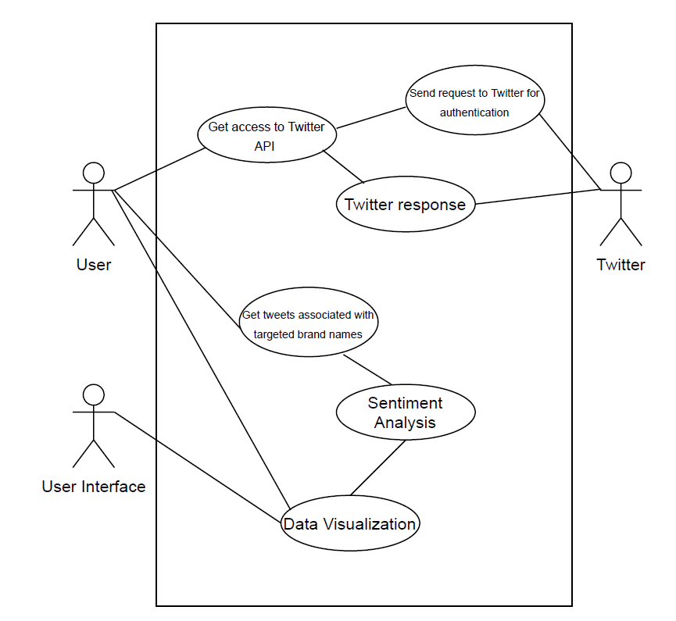
Use Case
User accesses data through Twitter API
Tweets by brand names
Sentiment analysis
Visualize the data

Slide 7
Python Packages
Data Analysis Tools Used
NLTK (Natural Language Tool Kit)
Naïve Bayes Classifier
PySpark – HashingTF, IDF, Tokenizer, AssemblerData
Multiclass Classification Evaluator
Assessed Values:
Polarity: Negative vs. Positive (-1.0 => +1.0)
Identifies words and phrases it can identify, assigns values, and calculates overall score

Slide 8

Getting the Data
Accessing the Twitter raw data
Read data into python using API
Create a dataframe of select Twitter feeds
Generate .csv file to be used to build the model

Slide 9

Data Preparation
Cleaning Dataset
Polarity Type
> 0 = “Positive”
0 = “Neutral”
< 0 = “Negative”
Split data into Training/Testing 80/20
Training Data = 7,433
Testing Data = 1,836
Index the polarity type

Slide 10

Data Analysis Process
Apply Spark Dataframe to manipulate and discover data
Preprocess Data
Tokenize the tweets
Remove numbers
Eliminate unnecessary words such as I, are, is, the,..
Stem text data
Preprocess Data
HashingTF
Term frequency transformer that vectorizes the text
Inverse Document Frequency (IDF)
Estimator that fits to the dataset and scales the hashed vectors
AssembleData – final_features
Combine IDF data and Polarity_Type
Raw Data
Clean Data
Vector Data
Prediction
Naïve Bayes Rules

Slide 11

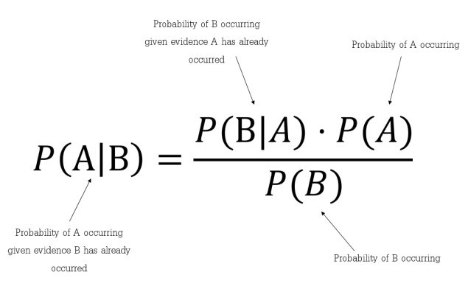
Building the Model
Naïve Bayes Classifier
labelCol = Indexed Polarity
featuresCol = TF-IDF Rescaled Data

Slide 12

Evaluating the Model
Multiclass Classification Evaluator
Generates predictions of the data
Tests accuracy of predictions to training set
91%
Model Accuracy

Slide 13




Alternate Models
Final Features = rawFeatures + polarity_index
Model 1 | Model 2 | Model 3 | Model 4
Brand Name Index | Polarity Index | Polarity Index | Brand Name Index
Final Features | Final Features | Features | Features
0.80338 | 0.90142 | 0.91449 | 0.78976

Slide 14
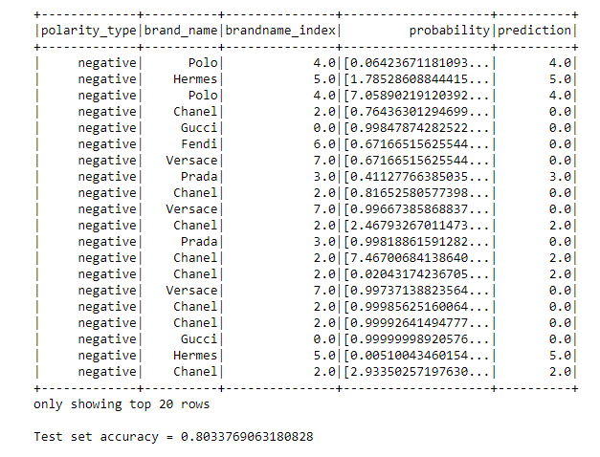
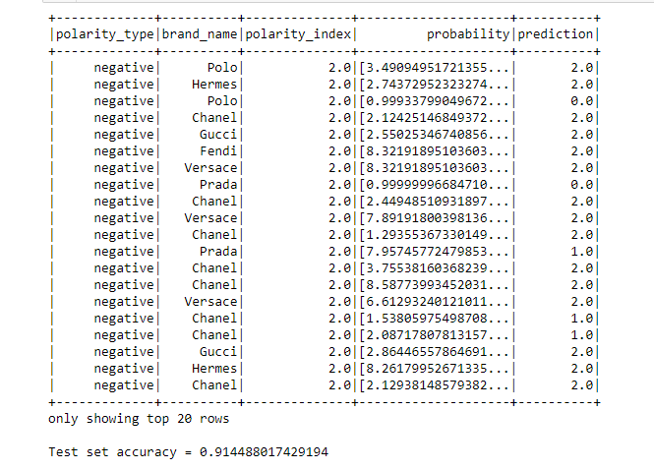
Models Selection
First Model
Third Model

Slide 15
Comparing Models
Midterm vs Current
Text Blob
Generates polarity and subjectivity
Rated sentiment on a scale of -1 to 1
Uses Pattern Analyzer
Based on pattern library
Naïve Bayes
Generates prediction
Rated sentiment on a scale of 0 to 10
Uses TF-IDF and Naïve Bayes

Slide 16

Business Impacts
Identify fashion trends
Input on what direction large companies are heading
Insight into public opinion
Helps to guide decisions around marketing and product development for our firm

Slide 17
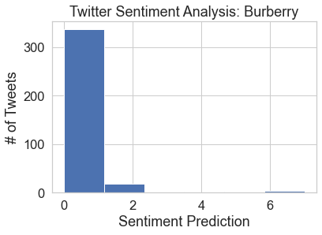
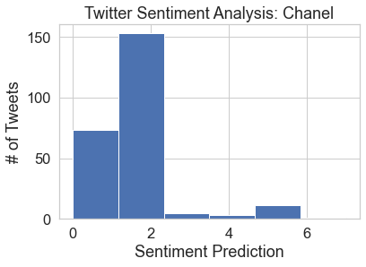
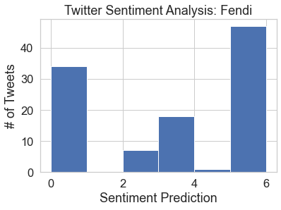
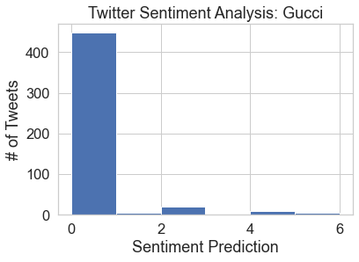
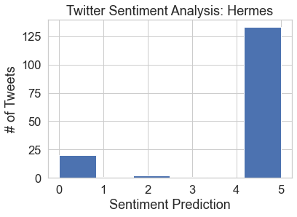
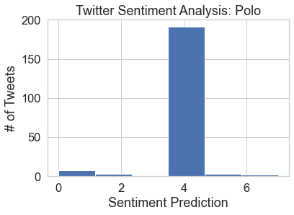
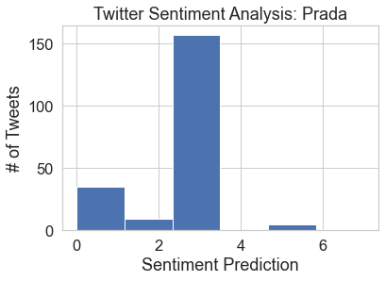
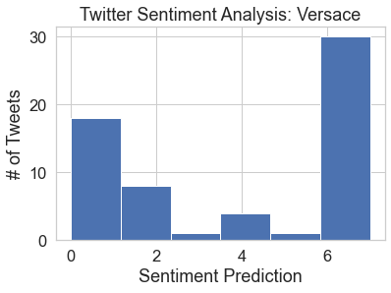
Company Analysis
# of Tweets: 362
# of Tweets: 246
# of Tweets: 107
# of Tweets: 487
# of Tweets: 157
# of Tweets: 208
# of Tweets: 207
# of Tweets: 62

Slide 18

Next Steps
Expanding the testing set
Using benchmark testing data
Cross validation of results
Running outside data through the model
Other uses in business:
Customer Feedback
Marketing
Performance Monitoring
Brand Monitoring
Voice of the Customer (VoC)

Slide 19
Thank you

